Slide 1
QI Webinar:
Using the QM Plan Checklist
October 26, 2021

Slide 2

Introductions
Please share your name and agency in the chat room

Slide 3
Reminder about Basic Zoom Functions
Picture Consent: You allow us to take pictures from our training events and post them on SharePoint and potentially on the AIDS Institute website; you have the right to revoke your consent for pictures that are publicly posted; at no time will individual names be used to identify you, unless you sign the appropriate release form

Slide 4


Good Practices for Zoom Participation
Re-label your Zoom tile to state your name
Keep video on and mute your line when needed
Use the chat room to ask for clarifications, post questions, or share your wisdom
Please be reminded that we will record our session for later replay!

Slide 5
Quality Management Plan
Expectations

Slide 6
What is a QM Plan?
A Quality Management Plan is a document that outlines the program-wide HIV quality program, including a clear indication of responsibilities and accountability, performance measurement strategies and goals, and elaboration of processes for ongoing evaluation and assessment of the program.
At least annually review and update the QM Plan as necessary

Slide 7
Why a QM Plan?
The AIDS Institute requires a Quality Management (QM) Plan be submitted annually
The QM Plan is your roadmap for all your QM activities
The QM Plan helps you evaluate your quality management efforts over the year
Defines your vision for your HIV services and its improvement goals

Slide 8
Why a QM Plan?
The Plan defines the staffing for the QM committee
The Plan defines how staff are chosen to be part of the agency quality management program
How people with HIV are involved in quality activities
Identify the senior management staff who are the driver of the quality management program

Slide 9
QM Plan Expectations – RW Part B Quality Standards
The Ryan White Part B-funded service provider has a written quality management plan that is reviewed and updated annually
The Plan is shared with staff and clients to gather input and to promote involvement in the quality improvement activities
The QM Plan includes a workplan that identifies implementation responsibilities and a timetable for their completion
  RW Part B Quality Management Plan Review Tool

Slide 10
Agency’s QM Plan
Your Part B QM Plan should reflect your Part B-specific quality improvement goals
You can either integrate the Part B QM Plan as a sub-set of the agency’s QM Plan or write a stand-alone Part B QM Plan
The QM Plan should reflect all service categories for which the agency is funded

Slide 11
Available Part B QI Resources
Tool | Details
Part B Quality Management Program Standards | To learn about the Part B QM Standards that are applicable to HIV service providers that receive Part B funding in New York State
QM Plan Review Checklist | To help with the development of future QM plans, the review of existing QM plans, and for providing feedback and guidance by internal and/or external stakeholders
Organizational Assessment Tool for Part B Service Providers | To identify all essential elements associated with a sustainable QM program and is in keeping with the Part B QM Standards and HRSA guidance, such as PCN 15-02

Slide 12
Quality Management Plan
Outline

Slide 13

The QM Plan is a Living Document
The Quality Management Team should:
Review the attainment of the annual goals - think about what worked and what didn’t
Determine if they are tracking the right data
See if the deliverables in the work plan have been met; if not what can be improved?
Make sure all staff know the Plan and its annual goals
Ensure that the voices of people with HIV are incorporated into the plan

Slide 14
QM Plan Expectations – RW Part B Quality Standards
The Plan includes the following elements:
  Quality statement describing the overall mission of the QI activities
  Annual improvement goals based on identified gaps
  Quality infrastructure
    how staff are involved in improvement efforts, including the agency leadership
    how the Part B QM committee is set up and evaluated
    how people with HIV are involved in QI activities
  Performance measurement activities describing indicators and data collection methodologies
  QI projects and the routine reporting of QI project updates

Slide 15
Quality Statement
Be visionary
Be realistic
Describe the ultimate goals of your QM activities
Example: “Our food pantry will be a resource for people with HIV in this community to obtain nutritious food stuffs as well as sound nutritional counseling to optimize health and HIV viral suppression”

Slide 16
Annual Quality Goals
Limit to 3 or 5 improvement goals maximum; don’t overburden staff
Focus on improvement and aligned with the annual AIDS Institute-issued Part B improvement goals
Your goals should align with your quality statement
Example:
  “100% of individuals being given a food supply will be offered nutrition counseling by December 2021”
  “We will develop and implement a rapid response program for individuals with emergent needs by June 2022”

Slide 17
Infrastructure
What is the roll(s) of the leadership in the quality program? How do they support it and what actions are taken from findings?
Define the rolls and the responsibilities of the QM committee members
Describe the process for annually updating the QM plan
Detail the involvement of people with HIV in the quality infrastructure

Slide 18
Performance Measurement
Expectation: data collection and analysis for the performance measures should occur quarterly at a minimum
How you select performance measures; who is involved in choosing measures
Outline the performance measures, their current performance, and their improvement goals
Outline what tools/processes are used to stratify the performance data
Detail who will conduct the data collection, data analysis, and review of data reports

Slide 19
Quality Improvement
Expectation: Each RW Part B funded provider should conduct at least one annual quality improvement project
The QM Plan should identify:
  The methodology used for improvement activities
  How improvement projects are selected and who selects them
  How people with HIV are involved in improvement activities
    Capacity building for people with HIV

Slide 20
CQM Program Evaluation
Did the organization achieve its aims? What did you learn from last year?
Were the quality improvement activities well documented?
Were the projects selected feasible?
Were key staff members involved in quality improvement projects?
  were all staff aware of the annual goals
  did all staff receive direction to help the agency achieve its goals
Did people with HIV have a role in the improvement activities?

Slide 21
Tips and Resources

Slide 22
Some Tips to Write and Update QM Plans
Tip - 80% planning, 20% writing (old software programming rule)
Tip - Don’t reinvent the wheel; ask for a sample from your peers to get started
Tip - No plan is complete until it addresses consumer input
Tip - The perfect is the enemy of the good (A “perfect” plan was probably written by a consultant and nobody has a clue what it says)
Tip - Plans are only as good as their implementation
Tip - If you haven’t changed the plan throughout the year, you probably haven’t looked at it

Slide 23
Time to Start…
Use the checklist to inform the elements in your plan
Develop your QM Plan with your QM committee
Make sure the voice of people with HIV are contributing to the plan
Share your QM plan with your AIDS Institute contract manager and get feedback

Slide 24
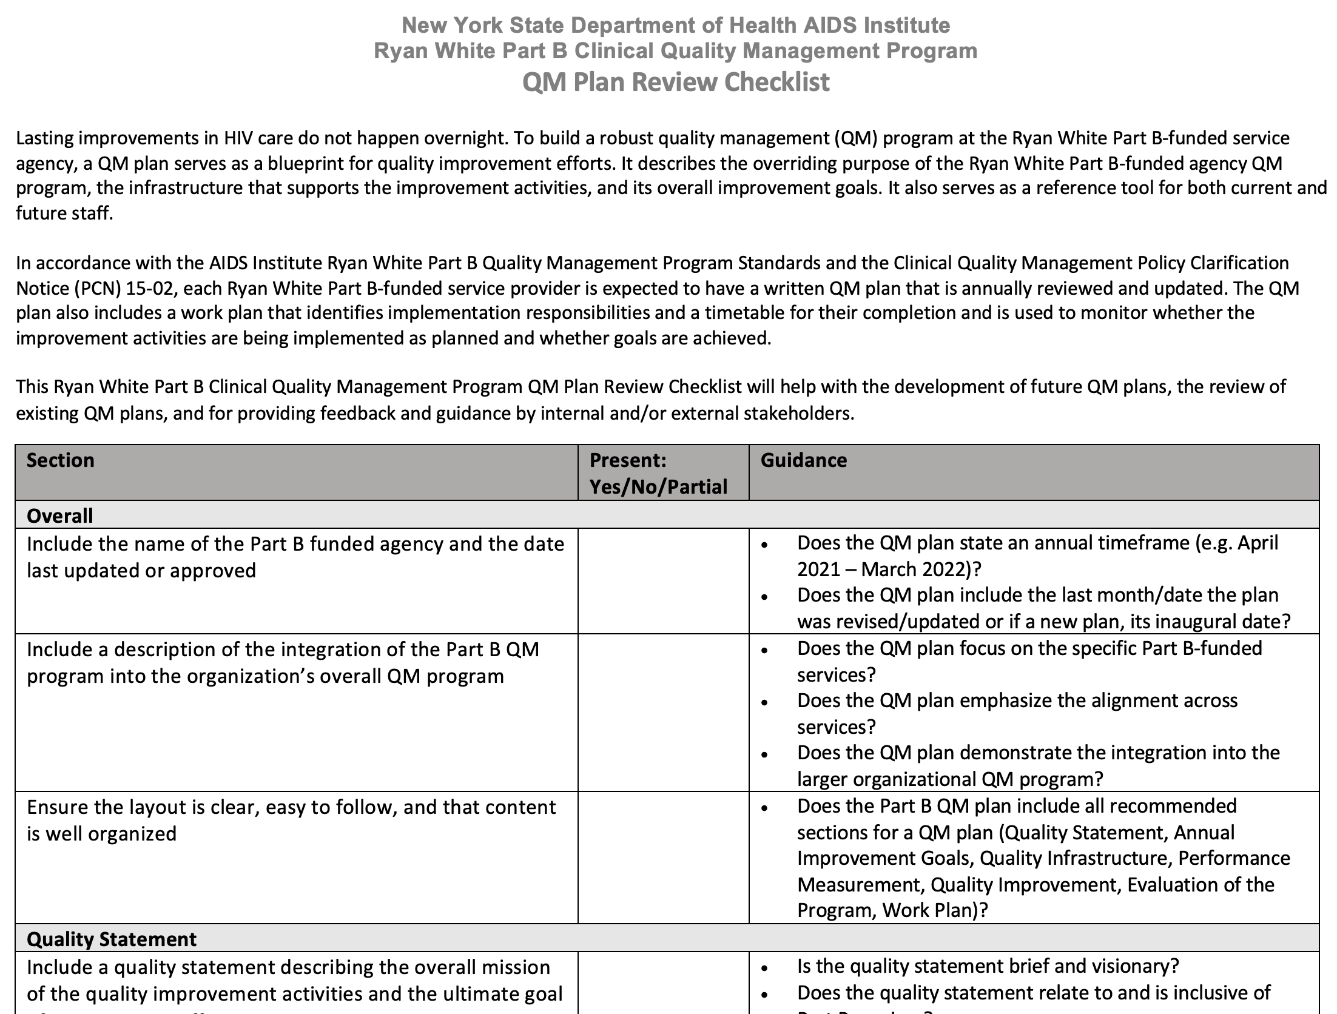
QM Plan Review Checklist
To help with the development of future agency-specific QM plans
To self-assess existing QM plans
To provide feedback and guidance by internal and/or external stakeholders

Slide 25
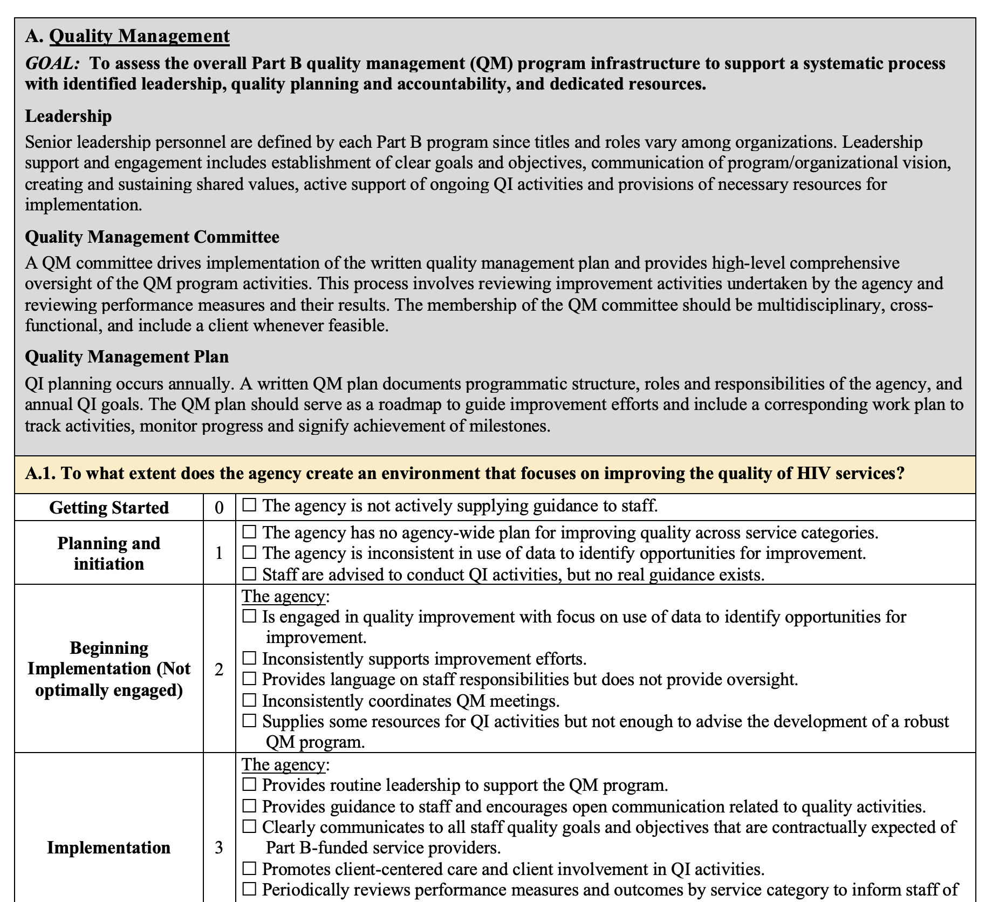
Organizational Assessment Tool for Part B Providers
To identify some of the elements associated with a robust QM program
To align with the Part B QM Standards and HRSA guidance (PCN 15-02)

Slide 26
Case Study

Slide 27
Case Study Instructions
Step 1: Form breakout groups
Step 2: Review the case study and use the RW Part B Quality Management Plan Review Tool, and answer the following questions
  What are the key findings?
  What technical assistance needs did you identify?
Step 3: Report back

Slide 28
Aha Moments and Wrap Up

Slide 29
Notes:
How helpful was today’s session to learn about quality improvement?
[1-not at all helpful, 2-not so helpful, 3-somewhat helpful, 4-very helpful, 5-extremely helpful]

Slide 30
Notes:
How engaged were you in today’s session?
[not at all engaged, 2-rarely engaged, 3-somewhat engaged, 4-engaged, 5-extremely engaged]

Slide 31
Notes:
How likely will you implement the lessons learned of this session when working with your programs?
[1-very unlikely, 2-somewhat unlikely, 3-neither likely nor unlikely, 4-somewhat likely, 5-very likely]

Slide 32


Slide 33
Contact Information
Kevin Garrett, MSW
Senior Manager, CQII
New York State Department of Health
AIDS Institute
90 Church Street, 13th floor
New York, NY 10007-2919
Kevin.Garrett@health.ny.gov

